Slide 1
Crowdedness at Campus Gym
Jeremy Friedman, Katie Grant, Hannah Li,
Nithin Saseendran, Sijo Valayakkad Manikandan

Slide 2
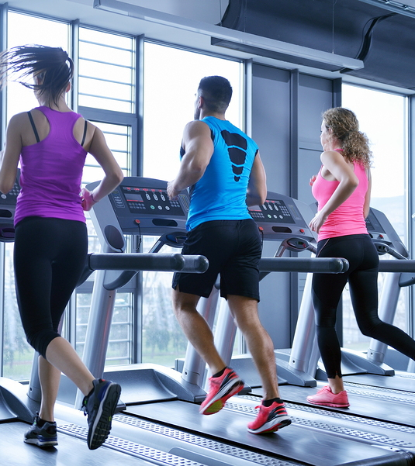
Problem
Can we predict the number of people at the campus gym?
Notes:
This will allow…
The gym to know when to have the most employees on duty
Busy MSBA students to know how to avoid crowds
Get a sense of how many machines or weights are in use

Slide 3
Dataset
Data collected every 10 minutes for 2 years at UC-Berkeley’s campus gym
62,000+ observations
Variables:
Number of people
Date
Timestamp
Day of week
Is it the weekend? (1/0)
Is it a holiday? (1/0)
Outside temperature
Is it the start of the semester? (1/0)
Is it during the semester? (1/0)
Month
Hour
Notes:
This dataset was obtained from Kaggle at https://www.kaggle.com/nsrose7224/crowdedness-at-the-campus-gym. The number of people in the campus gym was recorded every 10 minutes for 2 years at UC Berkeley. The dataset contains over 62,000 observations and provides information on the time of day/week/year the observation was recorded, and the outdoor temperature. We additionally added two lag variables that indicated how many people were at the gym 1 day earlier and 1 week earlier.

Slide 4
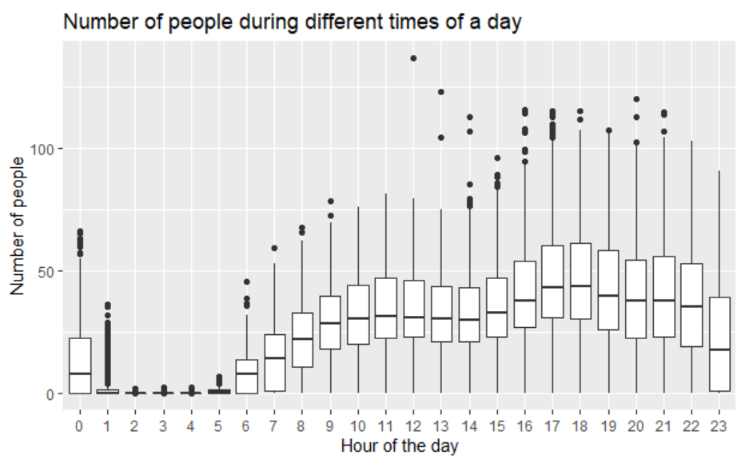
EDA
Notes:
As part of analyzing the data, we plotted different predictors against the target variable, i.e the number of people and tried to see if any patterns emerge. Two such plots are worth looking into.
First one is the the plot between hour of the day vs avg. number of people at gym. We can see that the number people going to the gym are low from 12 midnight till early morning 6 am. The number increases as the day progresses and then starts to decline after 10 pm.

Slide 5
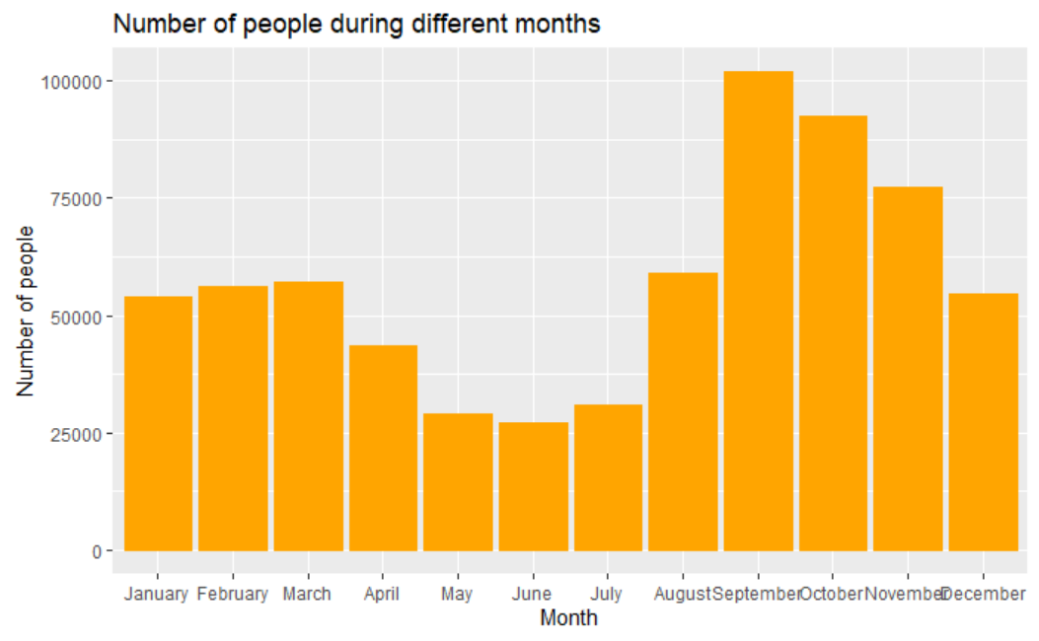
EDA
Notes:
The 2nd plot the average no of people at gym in a given month. As expected, the number is low during summer break and high at the start of fall semester.

Slide 6
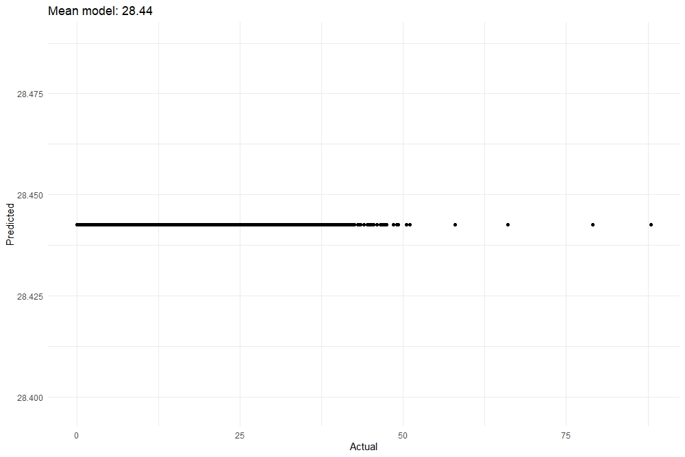
Simple Mean Model
Always predicts the mean number of people of the training data
Mean Model: 28.44
RMSE: 19.99
Notes:
Before we start our modelling, we’ll consider a Simple mean model which predicts the average no of people of the training data. This is just to give us a baseline.

Slide 7
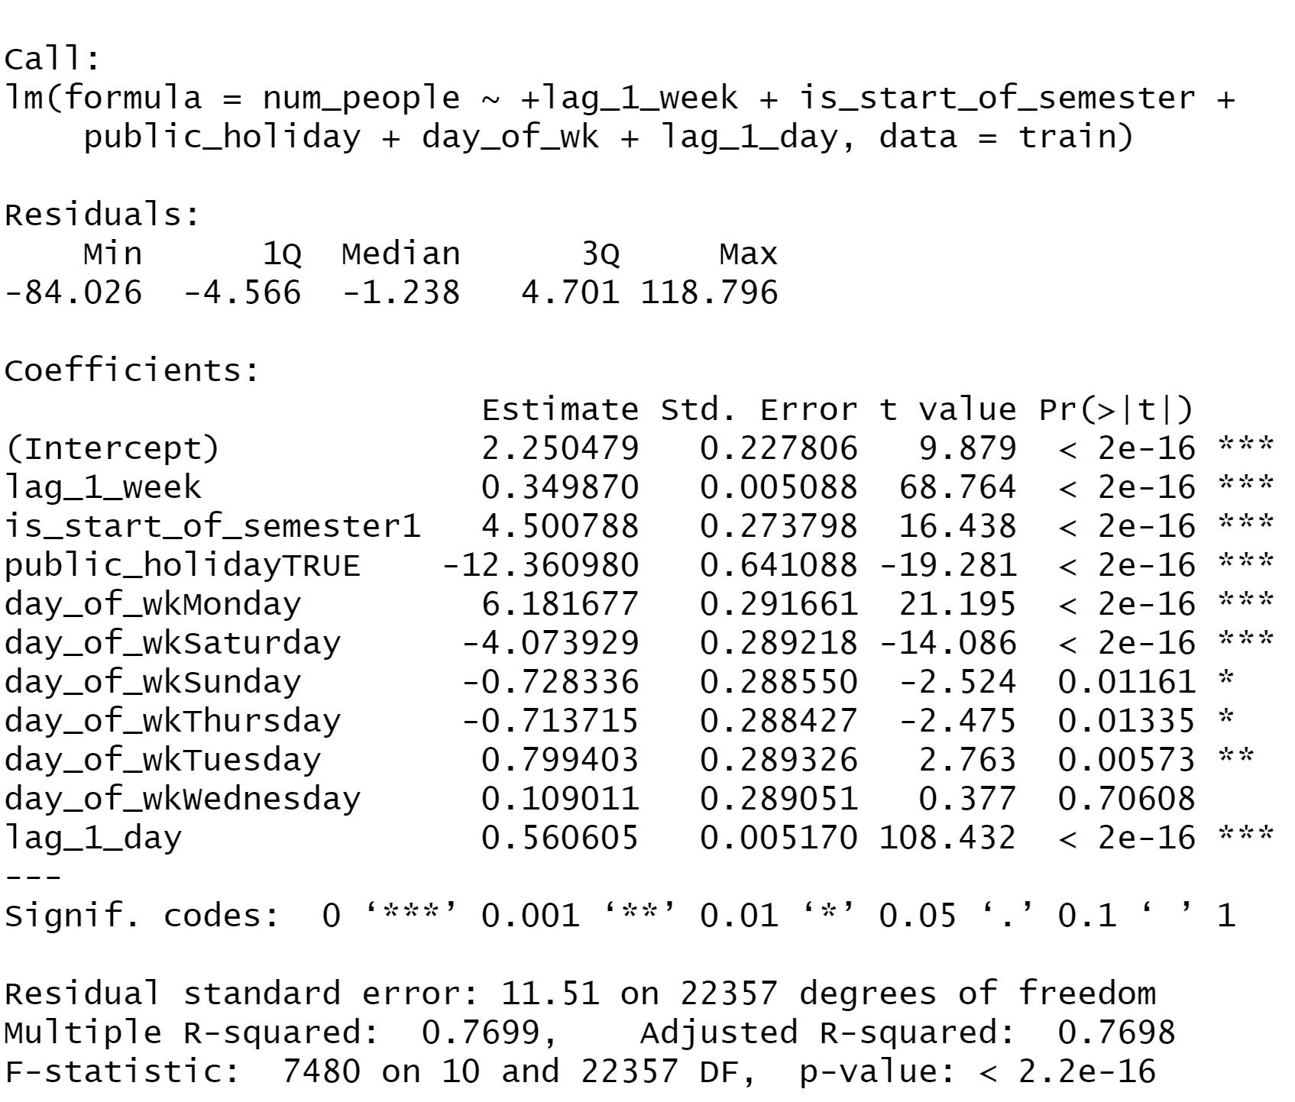
Multiple Linear Regression
Best Subset: 6 Predictors
Start of Semester: True
Day of Week: Monday
Day of Week: Saturday
1 Dag Lag
1 Week Lag
Public Holiday: True
Notes:
Here we can see the best 6 predictors for this dataset. Decrease in people for public holiday, and if it’s a saturday, and increase if it’s the start of the semester, if it’s monday, and for both 1 day lag and 1 week lag.

Slide 8
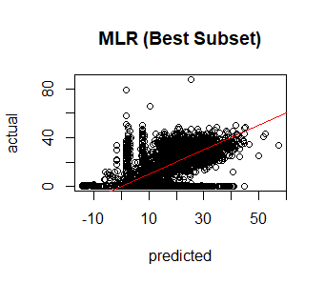
Multiple Linear Regression
Best Subset: 6 Predictors
Start of Semester: True
Day of Week: Monday
Day of Week: Saturday
1 Dag Lag
1 Week Lag
Public Holiday: True
RMSE: 1.708
Notes:
MLR has RMSE of 1.71! That’s really good but unfortunately MLR does not provide accurate response values. Since it has bounds of (-inf,inf), it is predicting negative response values and we cannot have negative number of people at the gym. This plot shows that this one area (bottom left of plot) has negative predicted values when they should be at or greater than zero.

Slide 9
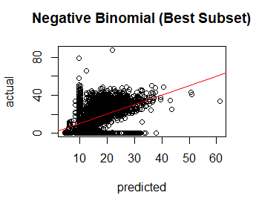
Negative Binomial Regression
Best Subset: 6 Predictors
Start of Semester: True
Day of Week: Monday
Day of Week: Saturday
1 Dag Lag
1 Week Lag
Public Holiday: True
RMSE: 4.914
Notes:
We account for MLR predicting negative response values by performing NB regression on the best subset. We see the RMSE increases to 4.9 but it is still fairly low and the model predicts accurate response values.

Slide 10
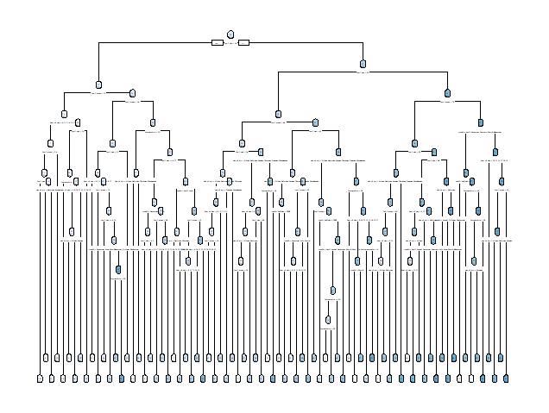
Decision Tree
44 Terminal Nodes
All 10 Variables Used
Test RMSE = 11.92
Notes:
A greedy forward search was used to create a large tree with 44 terminal nodes. This tree uses all 10 available variables and produces a test RMSE of 11.92. However, this tree is very complex and difficult to interpret, so we decided to prune the tree.

Slide 11
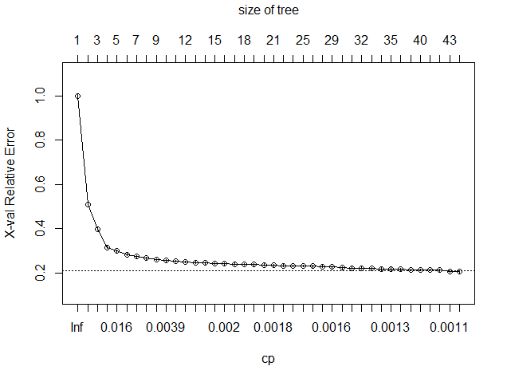
Decision Tree
Cross validation using the
1 SE rule selects
42 terminal nodes.
Notes:
Cross-validation was performed to determine the optimal tree size and a graphical summary of the cross validation error is shown. The 44 terminal node tree has the smallest cross validation error, but we used the one standard error rule to select a simpler model. So our pruned tree will contain 42 nodes.

Slide 12
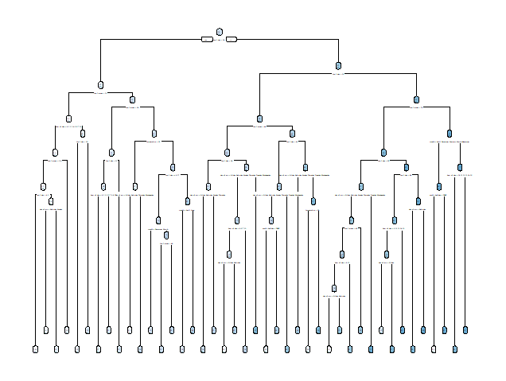
Decision Tree - Pruned
42 Terminal Nodes
All 10 Variables Used
Test RMSE = 12.10
Notes:
This is our final decision tree containing 42 terminal nodes. It produces a test RMSE of 12.10, which is slightly higher than our original tree. However, this tree is slightly less complex than the original tree. It still uses all 10 available variables. This tree shows the downside to using regression trees, because even the pruned tree is difficult to interpret and it still does not have the predictive power that we have seen with some of the other models.

Slide 13
KNN
Obtained RMSE = 22 for n=500.
Different values of ‘n’ yielded similar results. RMSE values ranged from 22 to 26.
KNN fails to model the dataset accurately and performs worse than a multiple linear regression model and simple mean model.
Plotted test data output variable with the predicted ‘y’ value to observe where the model is failing.
Notes:
Ran KNN model on the dataset for n=10,50,100,500 and 1000. RMSE values of all models ranged from 22 to 26.
KNN failed to model the dataset accurately and performed worse than a linear regression model.

Slide 14
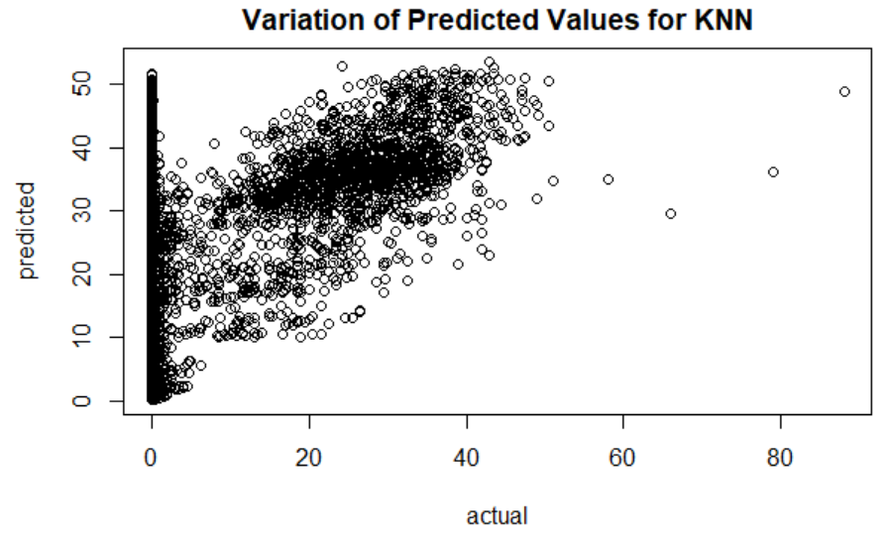
KNN
Predicted ‘y’ values vs the actual test values
Notes:
Plotted predicted ‘y’ values vs actual test ‘y’ values. Large variation of predictions at y=0 can be viewed from the plot.
This means that the model fails in predicting when there will be zero number of people at gym and hence resulting in a higher RMSE.

Slide 15
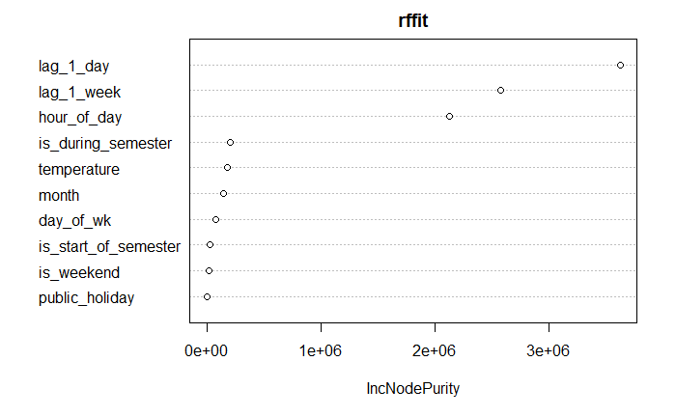
Random Forest
Most Important Variables
1 Day Lag
1 Week Lag
Hour of Day
Test RMSE
For 100 trees: 14.14
For 500 trees: 13.57
For 1000 trees: 13.39
For 5000 trees: 13.51

Slide 16
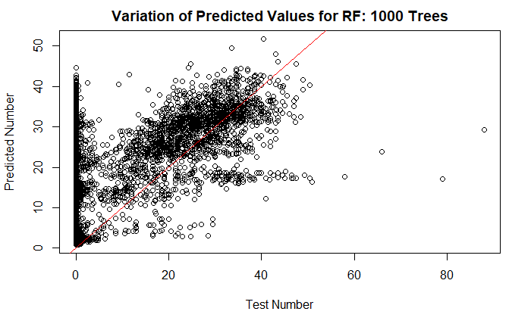
Random Forest
Model tends to overestimate the actual number of gym goers
High predictions made even when no one is at the gym

Slide 17
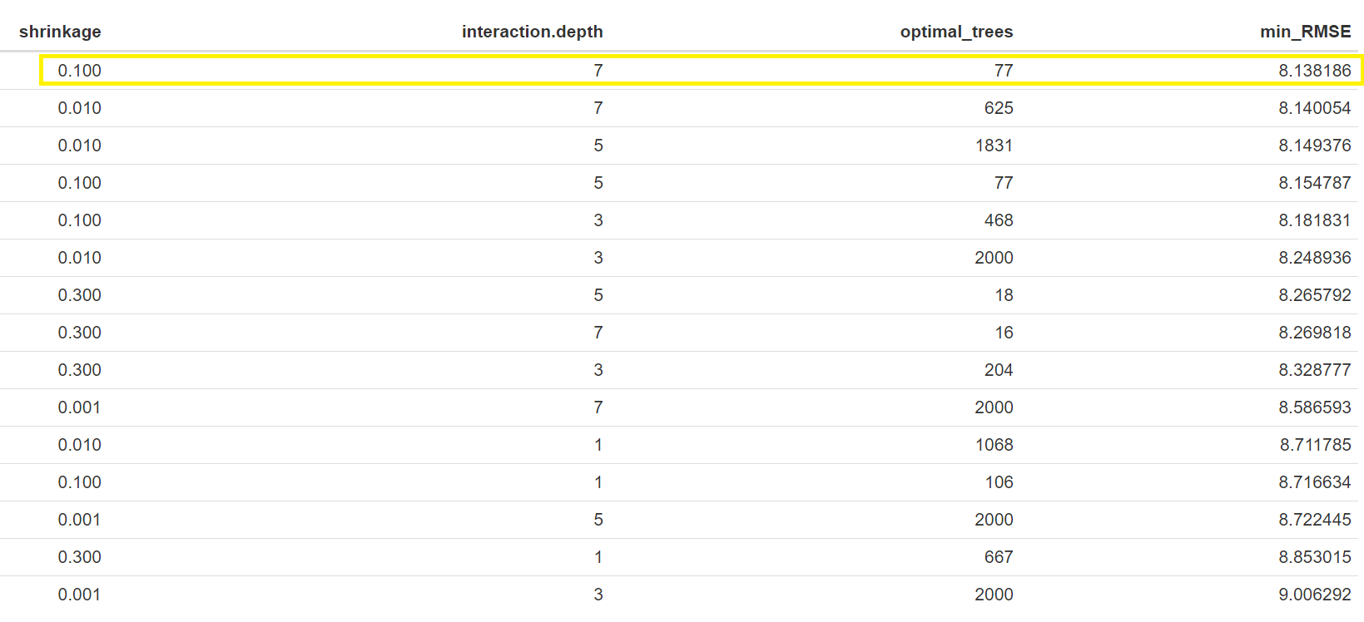
Boosting
Different values of shrinkage, depth and number of trees
Shrinkage: 0.100
Int. Depth: 7
Optimal Trees: 77
Min RMSE: 8.13 on validation dataset

Slide 18
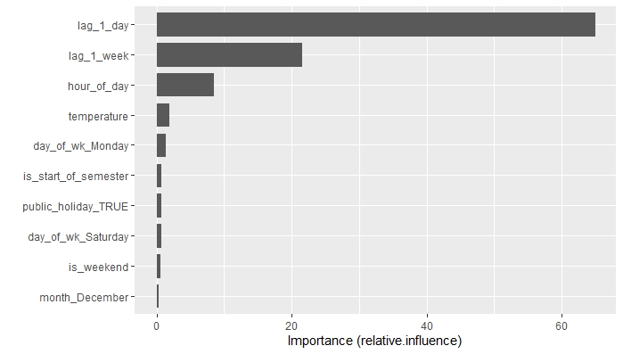
Boosting
Using selected parameters
Ran one more iteration using only top 5 variables
RMSE: 12.36 using top 5 variables
RMSE: 6.44 using all variables

Slide 19
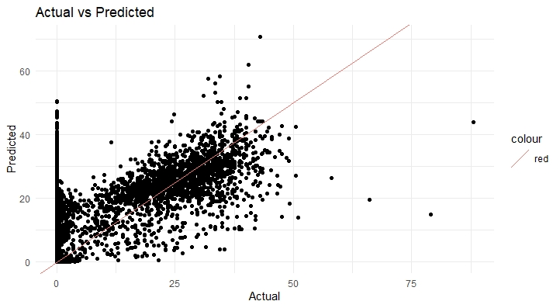
Boosting
Predicting high numbers even when no one is at the gym
More features to get info of the special days where there are no people in the gym

Slide 20
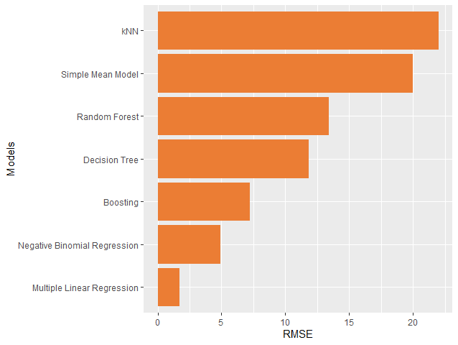
Model Comparison
Multiple Linear Regression produces the smallest RMSE, but predicts negative values.
Negative Binomial Regression produces the next smallest RMSE and predicts only non-negative values.

Slide 21
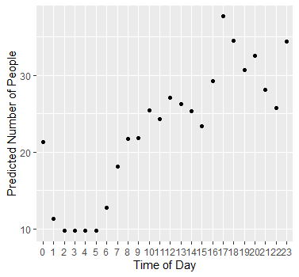
Final Recommendation
Students can see when the gym is least busy
The gym will know how many employees to have on hand
The gym can schedule workout classes appropriately
Notes:
Our final recommendation is to use the negative binomial best subset model to predict what days to go to the gym. With this model, students will be able to see when the gym is least busy, the gym will know how many employees to have on hand, and they can also schedule workout classes appropriately. These are just a few examples

Slide 22
Future Directions
Variables:
Add gym closure days that are not public holidays
If the gym has workout classes scheduled
End of semester
Final exam day
If there is a university-wide event that day (ex. Football game)

Slide 23
Questions?

